Slide 1
A Community Brain Injury Team's approach to working with the cognitive and emotional sequelae following brain injury
Dr Pamela Brown & Dr Jane Moir

Slide 2
Background
Team set up in 2014
Prior to this, only about 20 patients per year were funded for specialist brain injury rehab at a national centre e.g. Murdostoun. Spiralling costs.
Far greater numbers requiring rehab but not at threshold for inpatient centre – unmet need
Community rehab team set up comprising: Clinical Psychology, Occupational Therapy, Physiotherapy, Speech and Language Therapy, Assistant Practitioner.
Led to reduced use of national centres for inpatient rehab

Slide 3
The Community Brain Injury Team (CBIT)
Led by an AHP Consultant
Most referrals come from acute sites for individuals with new brain injury.
Also accept referrals from community sources e.g. GP, social work
Rehabilitation takes places in peoples homes, workplaces, local communities as required
Three acute hospitals in Lanarkshire but no dedicated brain injury/neurology ward. BI patients scattered across sites and wards.
Team can provide consultation to acute staff but in-reach work limited.

Slide 4
Referral Criteria
Non-progressive brain injury.
Individual has the potential to benefit from rehabilitation.
Age 16 and over
Resides within NHS Lanarkshire boundary
Patient or Guardian consents to intervention

Slide 5
Referral Pathway
Individuals with new brain injury are treated in one of three local hospitals or QEUH if they require surgical management. Currently no dedicated brain injury ward in Lanarkshire
All individuals with brain injury who require assessment or
rehabilitation are referred to CBIT.
Referrals are vetted against referral criteria and allocated for assessment.
An initial assessment is completed with the individual in the acute or community site
Assessment findings are fed back at the weekly MDT meeting.
Patient accepted for community rehabilitation and followed up at home. (83%)
Patient requires ongoing rehab in acute site prior to discharge – consultation & staff training can be provided by CBIT. (14%)
Patient requires an inpatient rehabilitation at a specialist centre
before discharge with community rehab ( 3%)

Slide 6
Consequences of Brain Injury
Four broad categories:
Physical
Cognitive
Psychological
Social
Notes:
We spilt the consequences that a brain injury can have into four broad categories....
And I’m going to speak a little about each of these in turn

Slide 7

Consequences of Brain Injury
- Physical
Fatigue
Balance
problems
Seizures
Weakness
Pain
Increased
tone
Sensory
changes
Falls
Notes:
First up we have the potential physical consequences of brain injury which i will cover very briefly as you will be getting more detail on these from our physios in their presentation later this morning
People can have difficulties with dizziness and balance following BI
They can have weakness in their upper or lower limbs of down one side of the body and they can be pysically deconsitoned as a result of a lengthy hospital stay
They can have increased muscle tone which means that there is too much tension in the muscles and they are tight and tense even when at rest and all of these are issues that can lead to increased risk of falls
Fatigue is a very common consequence of brain injury, even mild brain injury and the vast majority of patients we see will have problems with fatigue
Seizures are not uncommon in the early stages following brain injury and unfortunately people who have had a brain injury are at increased risk of developing epilepsy in the months and years following injury
People can have problems with pain which can include ongoing headaches. People may also have suffered orthopaedic injuries and may experience pain as a result of these.
They can also experience a range of sensory changes including visual changes which can include visual field deficits, inattention, reduced visual acuity, double vision and more. They can have problems with hearing including tinnitus, changes to smell and taste (people often prefer very swet or salty foods after injury)

Slide 8
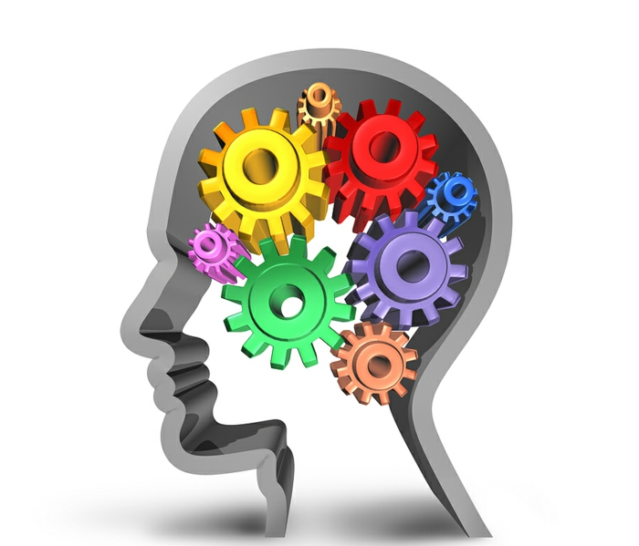
Consequences of brain injury
- Cognitive
Attention and concentration
Memory
Working memory
Speed of thinking
Executive function
Social communication
Insight
Notes:
Attention – 3 broad types
Sustained att – being able to hold your attention on something
Alternating/switching attention – being able to switch back and forth between two different tasks
Divided att – being able to multi-tasks, do more than one activity at the same time
Memory
Memory for past events is generally preserved
Immediate memory impacted – how well we can learn and take in new information
Delayed memory – how well we can remember what we have learned after a delay
Prospective memory – remember to do things in the future e.g. take meds
Working memory – holding information for a brief time e.g. briefly remember a phone number before writing it down or doing mental arithmetic – nanalogy of the mental blackboard
Speed of thinking – often reduced following brain injury. May be noticeable in conversation – allow extra time to respond
EF – refer to later presentation
SC – verbose, tangential – refer to later presentation
Insight – lack of awareness of their difficulties, can be a significant barrier to rehab and can impact on safety

Slide 9
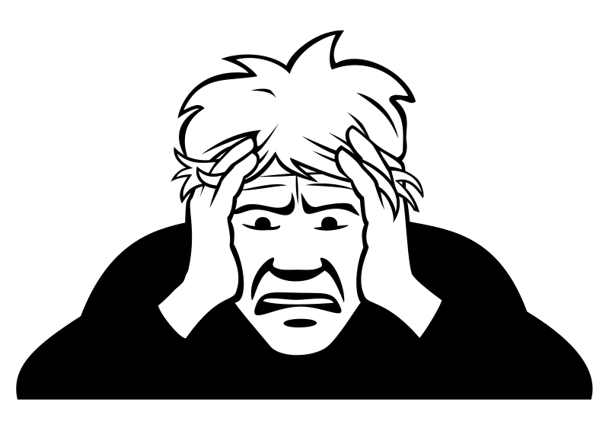

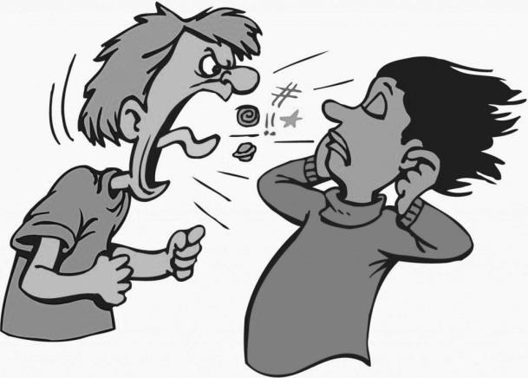
Consequences of brain injury
- Psychological
Depression/low mood
Anxiety
Adjustment
Anger/ irritability
Personality change
Emotional lability
Notes:
Brain injury is a massive sudden change. People can feel low and hopeless about the future and very anxious (about falling/ bleed of further aneurysms)
Can struggle to adjust – life and the future doesn’t look the same. In the early stages (acute), they may not yet know what they need to adjust to
Anger – may be psychological in nature (angry about what has happened to them/what they have lost) or organic (loss of control of emotions due to frontal lobe damage).
Personality – may be disinhibited (make hurtful comments), again mention SCD
Lability – loss of control of their emotions, very tearful or sometimes inappropriate laughter

Slide 10



Consequences of brain injury
- Social
Loss of independence e.g. driving
Communication changes
Lack of structure to the day
Difficulty retaining/ finding employment
Change in financial circumstances
Change in relationships
Reduced social circle
Loss of role e.g. family
Increased risk of mental health and substance misuse difficulties
Inability to continue with sports/ hobbies
Notes:
Driving is a huge issue for people. Must make them aware it is their duty to inform DVLA that they have had a brain injury. Common to lose license for at least 6 months and sometimes longer (e.g. seizures). Some people may require a driving assessment at Scottish driving assessment centre

Slide 11
Background Factors
Pre-existing mental health
Pre-existing physical health
Addiction
Debt
Social deprivation
Homelessness
Unemployment
Relationship difficulties

Slide 12
Inter-agency Working
Social Work
Other health services
Community Mental
Addictions Services
Active Health
Money Matters
Citizens Advice
Therapet
Visibility
Falls team
Veterans services
Carers Association

Slide 13
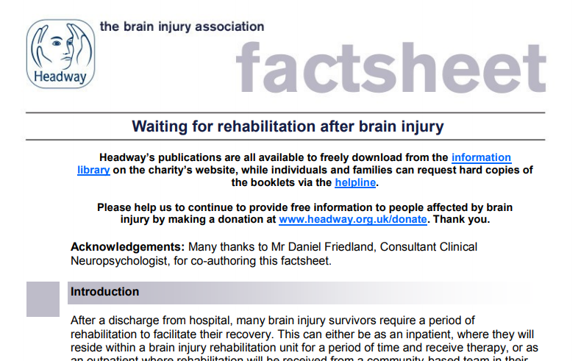
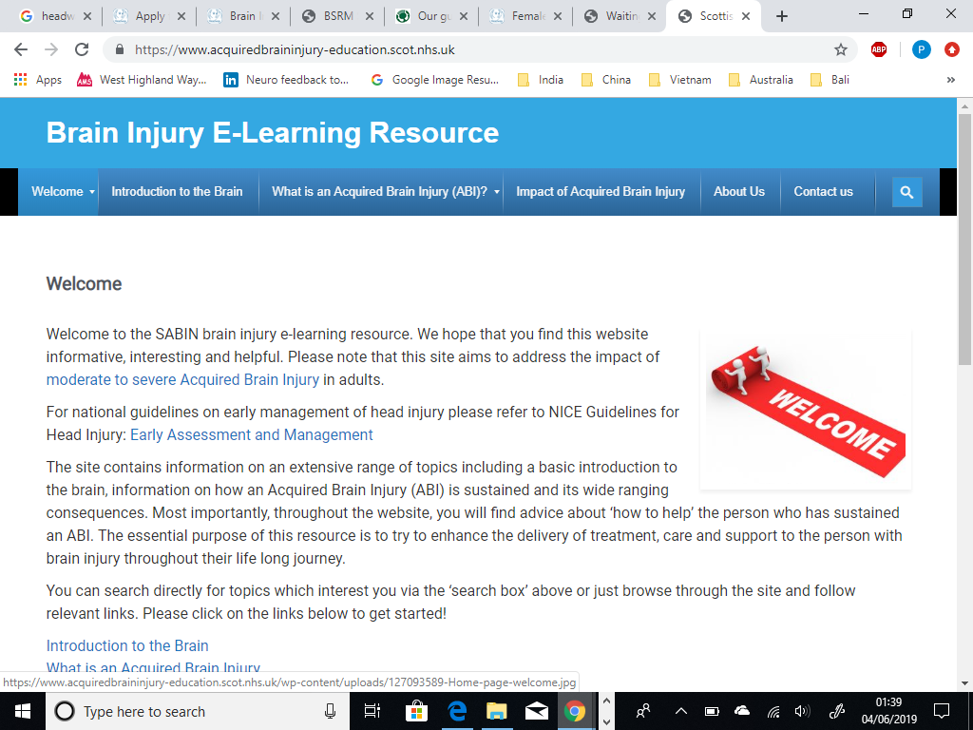
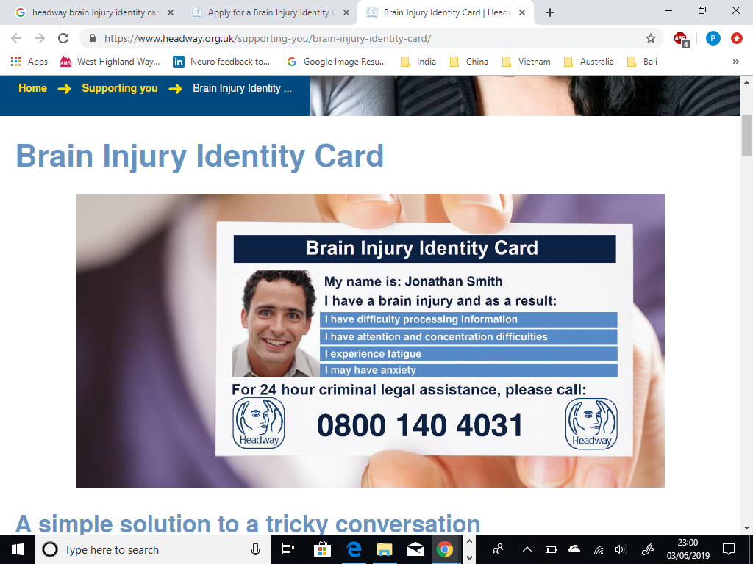
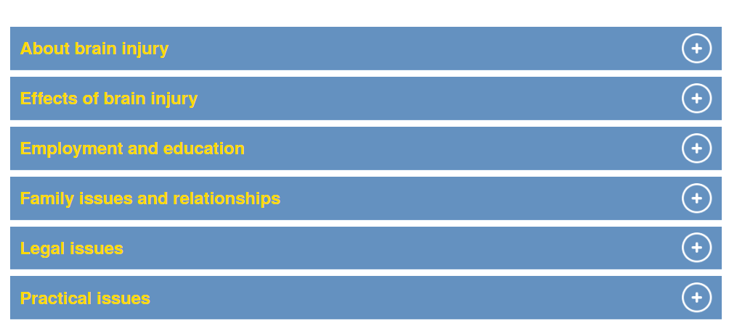
Resources
Headway – Information Library – www.headway.org.uk
www.acquiredbraininjury-education.scot.nhs.uk/
Notes:
The Headway Brain Injury Identity Card is designed to help police officers and staff more easily identify brain injury survivors and ensure that they receive an appropriate response and support.
The card can also provide brain injury survivors with added confidence in everyday social scenarios.
Each card is personalised, helping the card holder to explain the effects of their brain injury and request any support they may need.
At national level, the Scottish Acquired Brain Injury Network—SABIN—was established in 2007 with the key objective of enabling improvements in and access to services in Scotland for children and adults with ABI. It comprises service user representatives, healthcare professionals, service providers and voluntary sector groups. SABIN published the traumatic brain injury in adults standards, which ensure a joined-up approach to immediate and long-term care for people with an acquired head injury. To achieve those aims, it works with partners to bring together healthcare professionals, service providers, parents, carers and voluntary sector groups who support brain-injured patients. SABIN undertakes events and workshops to raise awareness, including the Brain Detectives event for children who have a relative with a brain injury, which provides education on the effects of such injuries.

Slide 14
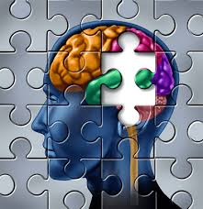
Role of the Psychologist within a brain injury rehabilitation setting
Working with the individual (and family)
Direct working: neuropsychological assessment to develop cognitive profile
Interventions: cognitive rehabilitation approaches, mood/ identity/adjustment/insight
Learning compensatory strategies and retraining skills. Working with families and carers
1:1 or group
Family work

Slide 15
Role of the Psychologist working within the Team
Positive working and learning environment - Training, consultation, supervision, reflective practice, shared learning, managing risk, collaborative working
Neuropsychological Rehabilitation = concerned with the amelioration of cognitive, emotional, psychosocial and behavioural deficits caused by an insult to the brain…… (Wilson, 2013)
To achieve their optimum level of physical, psychological, social, and vocational wellbeing (McLellan, 1991)
Drawing on range of clinical/neuropsychological models
Holistic formulation which considers wider context of the individual
Shared understanding (within team and between team and individual) Formulation within a biopsychosocial framework (WHO-ICF)
Meaningful, functional goal-directed activities

Slide 16
Holistic Neuropsychological Formulation Framework
Social factors
Person
Sense of identity
Brain pathology
Cognition
Affect
Physical
Insight
Loss
Functional abilities
Goals
Prof. Jon Evans & Dr Jessica Fish

Slide 17

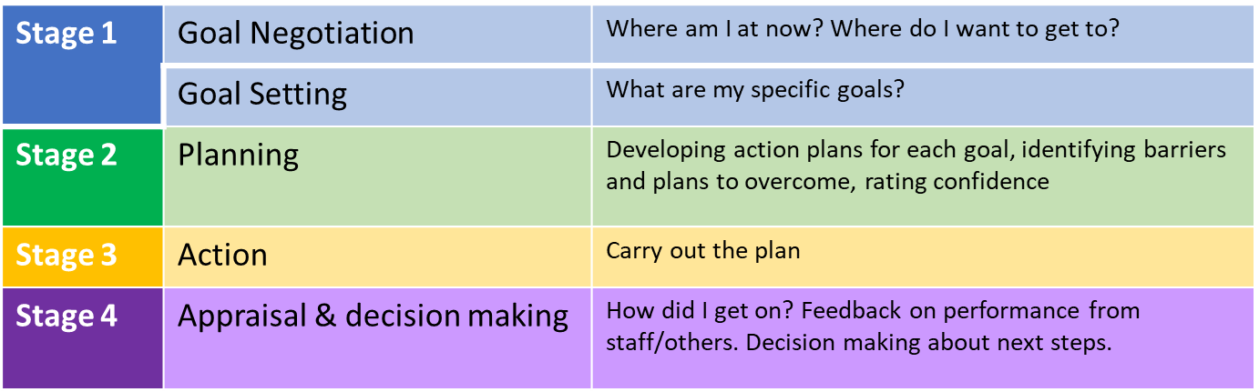
Goal setting and Action Planning (G-AP)
G-AP (Scobie et. al., 2011) is a framework to support person centred goal setting practice
It helps us to support people to set, work towards, attain and (if necessary) adjust their personal rehabilitation goals.
Stage

Slide 18
G-AP (Scobie et. al., 2011)

Slide 19
Case Study – “John”
Disclaimer – Fictional, but true
Age 43, forklift driver, lives with wife, son living nearby
BRAIN INJURY
fell down stairs. LOC: 20 mins, GCS: 6/15, PTA: 2/52
Neuroimaging: right acute subdural haematoma, frontal contusions, orbital roof fracture, right optic disc oedema
Treatment: Managed conservatively

Slide 20
Early Stages – Acute Hospital
PTA for 2 weeks – confused/disorientated
Referral to CBIT for agitated behaviour/wandering
Assessed, guidance for staff on PTA, environmental management, pharmacological advice
Education/support for family (SABIN/Headway)

Slide 21
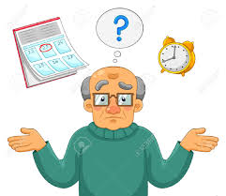
Features of PTA
Confusion and disorientation to time, place or person
Inability to lay down new memories
Reduced awareness
Wandering
Extreme fatigue
Uncharacteristic behaviours
  violence, aggression, swearing, shouting and disinhibition
  or more passive, docile, loving and friendly
Notes:
Disorientation - they may not know what year it is, where they are (may think they’re at home) or be able to recognise familiar people like friends and family
Inability to lay down new memories – even if you’ve just provided them with information they may forget it almost instantly
Reduced awareness – may be unaware they have had an injury and are in hospital
And they may be likely to wander and attempt to leave the ward
Disinhibition – taking their clothes off, sexualised or otherwise inappropriate behaviour. And family will tell you that the person would never have acted this way before and would be mortified
Or in more rare cases...more docile

Slide 22
Assessing PTA
Galveston Orientation and Amnesia Test (GOAT)
What is your name?
What time/day of the week/date/month is it now?
Where are you now? (City and Building)
When were you admitted to hospital?
How did you get here?
What is the first thing you can remember after your injury?
Quick and easy to administer in ward environment
Scored from 0-100
A score of ≥76 on 3 consecutive days = out of PTA
76-100 = Normal 66-75 = Borderline < 66 = Impaired
Notes:
For all the reasons already mentioned, it is vital to know when someone is in PTA and when they might be emerging
The lower the score the deeper in PTA the individual is

Slide 23
What can staff do to help?
Reduce the risk of harm e.g. 1:1 observation
Use a rota of familiar staff
Identify yourself every time you see the patient
Speak slowly and allow time to respond
Try not to directly challenge a delusion as this may increase distress
Use distraction and redirection
Provide reassurance
Avoid excessive questioning about what they remember
Be mindful of fatigue
Notes:
Identify yourself every time you see the patient
Tell them briefly what has happened to them and where they are e.g. You had a fall and you’re in the hospital
Provide a whiteboard near the patients bedside to display information e.g. Day, date, location and the names of the staff members looking after them
Patients can only be oriented to day, date etc. if they are given the opportunity to learn it
Seek specialist neuropsychiatric medication advice if the patient is agitated/ distressed. Certain medications can increase confusion, depress PTA scores and increase challenging behaviour (e.g. neuroleptics; benzodiazepines)
Avoid sensory-overstimulation - The brain is struggling to cope with the injury, and too much stimulation is best avoided e.g. noisy environments and bright lights

Slide 24
Adapt the Environment
Avoid sensory over-stimulation
Darkened room
Quiet
No TV/ radio/ iPad/ phone
Use a toileting schedule
Provide a whiteboard near the patients bedside to help orientate the patient
Allow the patient to walk around the room/ward with supervision if safe
Notes:
If a person presents with a delusion e.g. They think they are working at the hospital or need to leave to go to a meeting, it may be best not to challenge them. If you try to correct them and tell them they have had a brain injury and are in hospital they may be very distressed but they will forget this information again very quickly. It may be better to distract/redirect them instead e.g. Oh i think that work meeting has been delayed, lets get a cup of tea first
Avoid testing the persons memory by excessively questioning them. Think of how distressing it may be for the patient to be constantly quizzed by staff and family members when they do not know the answers to the questions
Instead encourage family members to....
Help to educate families on PTA by providing information about what is happening to their loved one e.g. Headway leaflets
1:1 observation may be needed to prevent the patient from wandering on the ward which may increase their risk of falls or from absconding from the ward

Slide 25
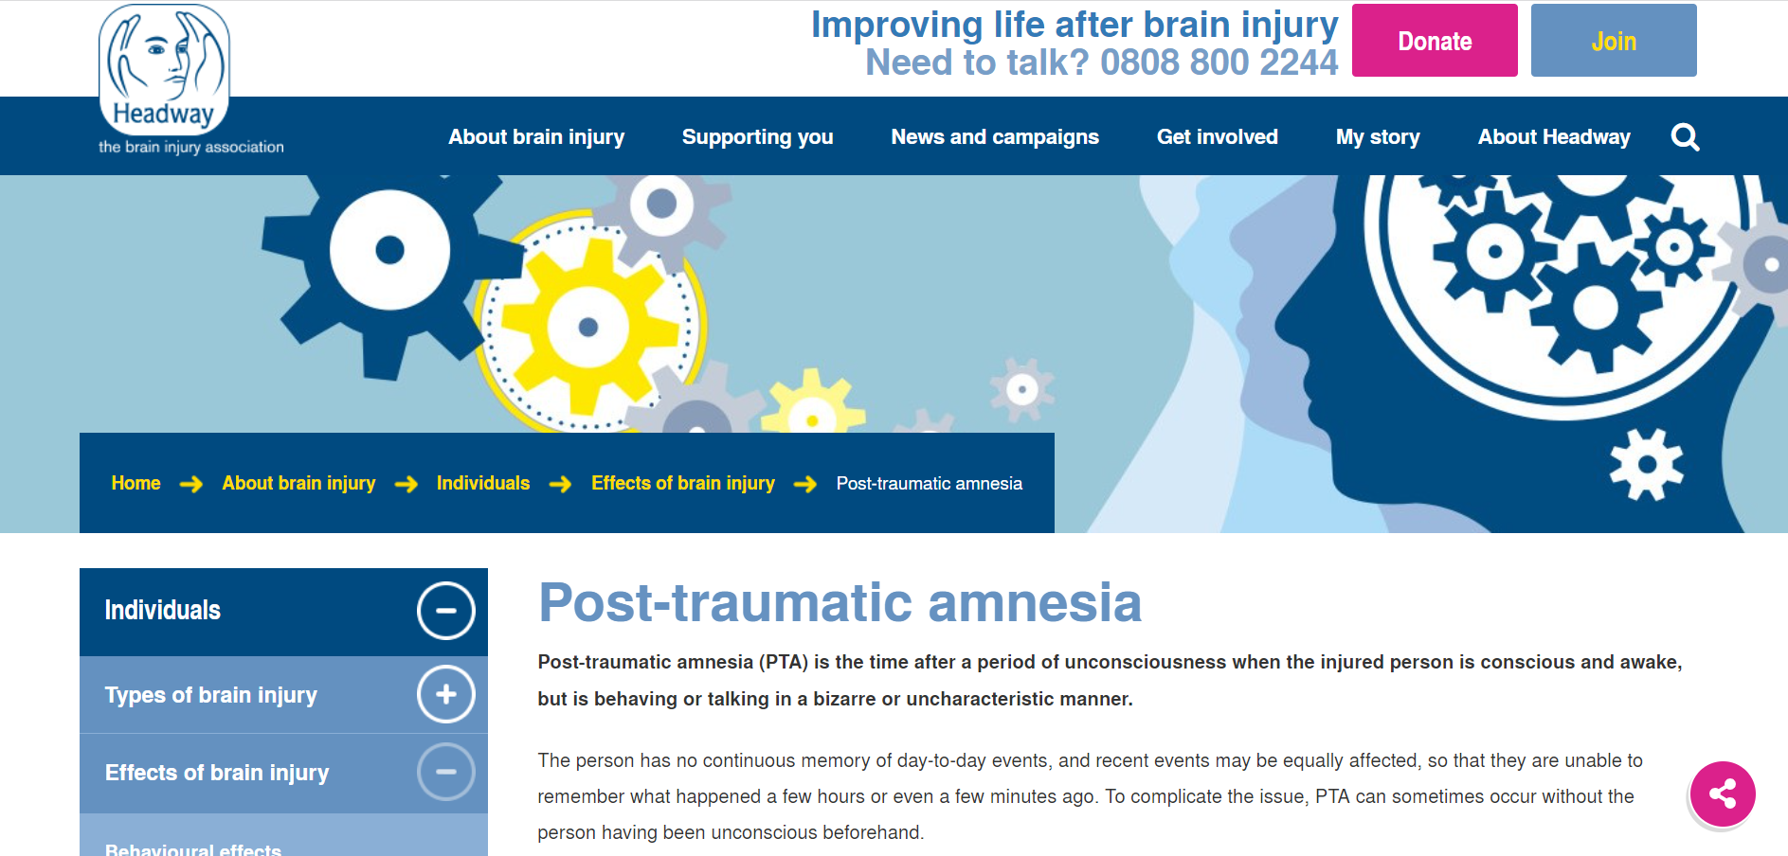
Educate Families
Provide family with information (Headway have some really good factsheets online)
Encourage family to talk to the person about pre-injury life and the things they used to do
Allow family to bring in pictures and familiar objects from home where possible
Limit length of family visits
Limit number of visitors to two
Ask them to speak slowly and one at a time

Slide 26
Medication Management
1st line treatments are environmental modification and appropriate staff management
Medication management can be helpful in managing agitation/aggression but it is a specialist area
Specialist neuropsychiatric medication advice should be sought
Neuroleptics and benzodiazepines should not be prescribed for patients in PTA
Their use in these patients is harmful
Medications with sedating effects may further impair cognitive function, increase confusion and exacerbate behavioural difficulties in PTA

Slide 27
Emergence from PTA
Medically stable, awaiting ophthalmology follow-up (diplopia), family able and willing to support at home – no social work/care package required at this time
Lacked insight, believed he could return to work/driving asap
Discharged Home: 3-4 weeks post-injury
- CBIT initial screening assessment, then interdisciplinary assessments

Slide 28
Team Assessment Outcomes
Physiotherapy: indep. mobile however balance issues (several falls in hospital), could manage stairs but more impulsive/distractible when fatigued. Reduced co-ordination in left upper and lower limbs, limited hand-eye co-ordination due to diplopia
OT: Independent with basic ADLs, attention/verbose – impacting on kitchen tasks, reduced insight, significant fatigue
SLT: Extremely talkative, pressure of speech and tangential at times, very repetitive re: driving, impulsive, emotionally labile – tearful
Psych: Orientated, memory ok – good recall between sessions. EF – slightly disinhibited, quite perseverative on specific topics, insight/awareness reduced, deficits in attention. Mood: frustrated, irritable, quicker to anger, emotional lability (tearful)

Slide 29
Developmental history and premorbid function (‘Early Life’)
Normal developmental history. School-leaver age 16. Married at age 20. Variety of manual jobs, working as forklift driver in current post for 10+ years. No premorbid mental health or substance misuse difficulties.
Psychosocial Context (Family & Social)
Lives with wife. Son (20) lives nearby
Supportive wider family
Forklift driver
Supportive employer, colleagues
Network of friends (golfing)
Person
“John”, 34
Identity (‘Who I am’)
Family man
Hardworking
Limited emotional expressiveness
Physically active/fit
Sociable
Neurological Condition (‘Brain Stuff’)
Fall down stairs, PTA 2/52
Neuroimaging: right acute subdural haematoma, frontal contusions, orbital roof fracture, right optic disc oedema
Managed conservatively
Physical
* Diplopia
* Balance issues
Reduced co-ordination in left upper & lower limbs
Deconditioned
* Fatigue
Emotion and Mood
Frustrated
Irritable
Quicker to anger
Emotional lability (tearful)
Reduced insight/awareness impacting on adjustment
Reduced awareness of wife’s emotions
Cognition (‘Thinking skills’)
Intact intellectual abilities
Slowed speed of processing
Can recall information, though learning impacted by attentional deficits
Reduced attention – distractible, perseverative on topics of concern
EF - Slightly disinhibited
Communication
Extremely talkative
Tangential
Pressure of speech
Social communication deficits
Aware of some physical issues though reduced insight/awareness of current cognitive difficulties
Behaviour of concern
Irritability - relationship with wife and son
Engagement in activities
Can just return to work and driving
Goals
SEE NEXT SLIDE
Participation & Functional Consequences (‘Everyday consequences’)
Independent with basic ADLs, struggling with kitchen tasks, not able to drive, paid sick leave from employment, not engaging in previous hobbies
Template produced by: Jon Evans, Jess Fish, Jill Winegardner, Shai Betteridge, Sanjay Sunak, Jenny Limond, Jenny Jim & Suzanna Watson

Slide 30
Goal Setting with John
Where am I at?
I’m grumpy with my wife, I can lose my temper over nothing. I feel useless around the house, a burden, not providing. Don’t feel in control. My left side isn’t as strong now. I can be a bit wobbly.
Where I want to be?
I want to be able to jump in the car and go where I want. Want to feel calm and in control. Get back to work and do more around the house (DIY).

Slide 31
John’s GAP Goals
To keep my cool & manage my temper
To be able to play a round of 9 hole golf with my friends
To be able to complete DIY tasks around the home
To return to work
To return to driving

Slide 32
Action Plan – To keep cool and manage my temper
To learn about the factors that influence my temper
To learn how anger impacts my body – fight or flight
To learn a breathing technique to help me manage the physical symptoms
To keep a record of times I lose my temper -with help
To practice ‘STOP & think’ before reacting

Slide 33
Interventions
Physio: HEP for strength, balance (AP support), moving on to attend gym….
AP – walking programme, attending gym, playing golf

Slide 34
Lifestyle
Higher risk of sedentary lifestyle (Mossberg et al, 2010)
Combination of physical/cognitive changes - circle of inactivity
Physical Impairments
↓Self Esteem
↓Socialising Community access
↓Motivation/Initiation
Fatigue
Premorbid Lifestyle
Goals to ↑ activity and lifestyle changes PRIOR to D/C for maintenance (Hamilton et al, 2016)

Slide 35
Interventions
Keyworker - referrals to Money Matters (benefits), carers service. Signpost to Headway and SABIN websites. Provision of driving information.
OT: fatigue management (with wife) – rest breaks, getting out of ‘boom/bust’
Structuring day – calendar, diary, talk time before kitchen tasks (not during)
VR Hub – DIY assessment (flat-pack furniture), liaising with employer – work strengthening
Driving ax.

Slide 36
Fatigue
“Others can’t see it ... I don’t look different... They think she’s just a bit lazy”
“It’s just like a wave that sweeps over you out of nowhere”
“It’s just like this cloud that comes over... My brain will shut off ... It just can’t cope with it”

Slide 37
Triggers of Fatigue
Physical
Over activity
Boom and bust
Poor sleep
Mental
Trying to concentrate
Trying to remember things
Slowed thinking speed
Emotional
Depression/feeling low
Stress – family/work/finances
Hiding difficulties
Environmental
Overstimulating environments e.g. Busy/ noisy places, bright lights
Lack of rest places

Slide 38
Managing Fatigue -The 4 P’s
Pacing: avoiding boom and bust, regular rest periods and micro-breaks
Prioritising: which tasks are essential?
Planning: organisation of an individuals day/tasks in advance
Problem solving: it’s not what you do, it’s how you do it
Notes:
Prioritising: which tasks are essential? In an inpatient setting educating family on fatigue and potential impact of long family visits

Slide 39


Interventions -Cognition
Cognitive rehabilitation is not about restoring lost functions e.g. ‘improving memory’ but aims to help people to compensate for their cognitive deficits by using strategies and aids
Person may struggle to take in new information or to remember information after even a short delay.
Remembering to do things in the future such as taking medications can be difficult (prospective memory)

Slide 40

Memory Rehabilitation
The aim is to reduce the functional impact of memory problems by reducing experience of failing to remember to do something or learn something new
Environmental modifications
– structure and routine, labels, signs
Compensatory aids
– paper or electronic diaries (prompts), Alexa, checklists, orientation whiteboard
Notes:
Benefit of electronic aids over paper diary

Slide 41
Communication
Thinking
Processing
Recognising emotions
Humour
Social rules
Recognising & remembering
Cognitive communication disorder

Slide 42
How cognitive impairment affects communication
Attention and Concentration
Memory
Resisting Distractions
Keeping track of conversations
Staying on topic
Repetitions when talking
Losing track of topics
Mixing up instructions or messages

Slide 43
How cognitive impairment affects communication
Executive Function
Social Cognition
Difficulty initiating conversations
Interrupting others
Poorly organised speech
Verbosity
Egocentricity
Difficulty understanding sarcasm (getting the joke)
Difficulty taking on someone else’s views or responding to feedback from others
Difficulty selecting the correct ‘filter’ for the situation

Slide 44
Why is therapy important?
Communication
Friendships
Relationships
Self- identity
Well-being
Confidence
Online
Workplace

Slide 45
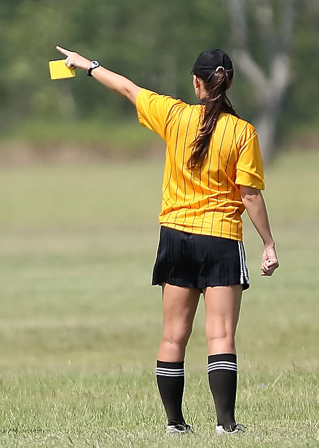
Management
Conversational Skills Training
Self monitoring and awareness of social cues
Social Scripts
Functional goals
Group work
Conversation partner training

Slide 46
Interventions - Communication
SLT: Verbose, blunt, less social filter, fixated on topics.
Communication partner support
Social communication, social scripts to use in certain situations to limit amount of info disclosed re: brain injury, scripts for ending conversations, increasing range of topics to discuss in varying social circles
Attended online peer support group

Slide 47
Interventions
Psychology:
Insight-raising – education on b.i. consequences, EF psychoeducation, irritability (flight or fight), recognising emotions earlier – ‘stop and think’ to reduce impulsivity, walking away from situation
Monitoring of irritability (John and wife) – aligning with fatigue management work

Slide 48
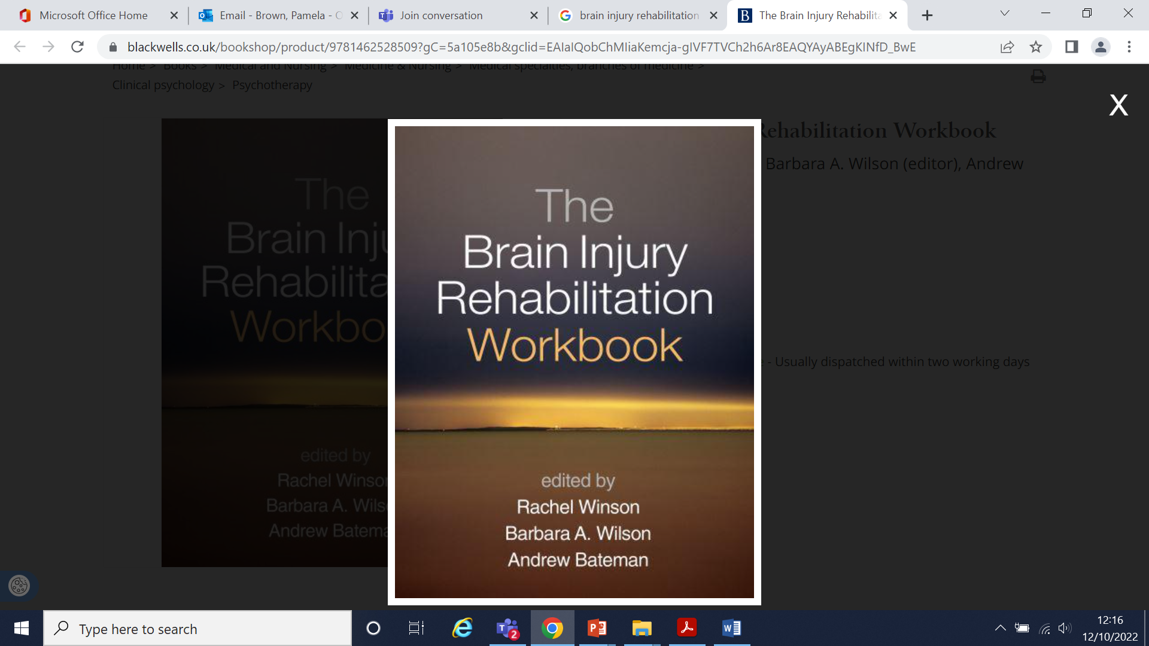
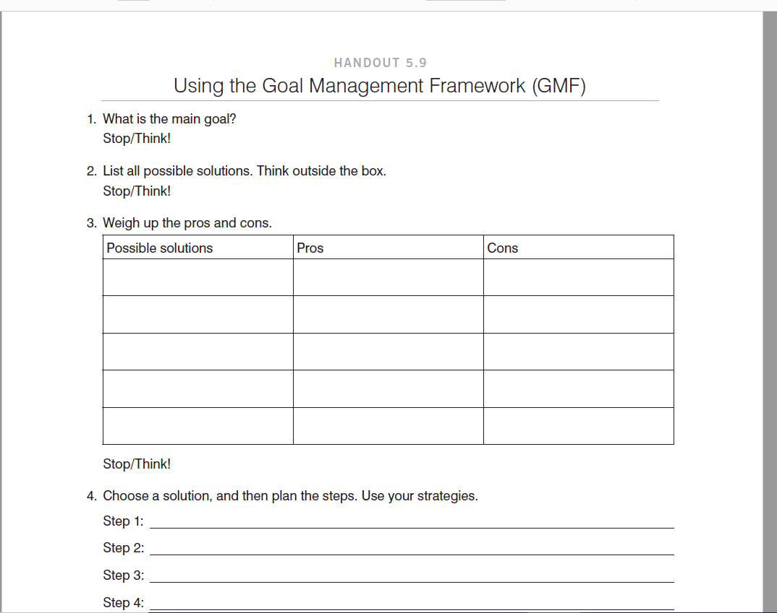
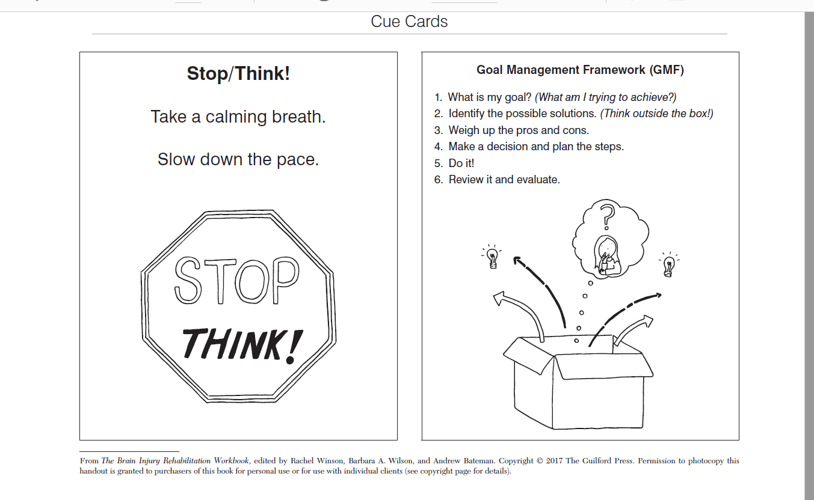

Slide 49
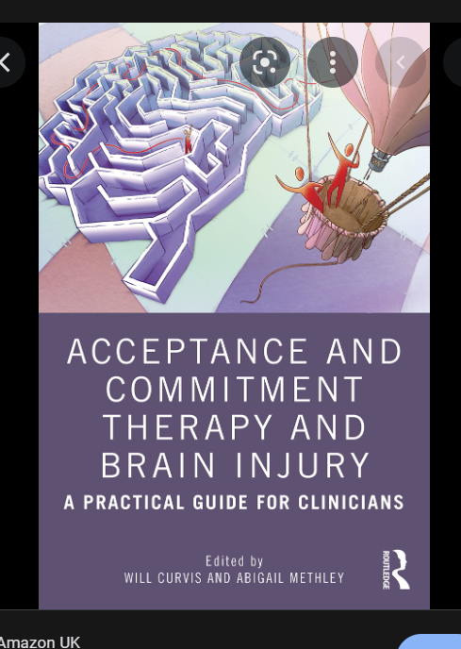
Interventions
Adjustment/mood monitoring – ACT approaches – utilises mindfulness and various tools/techniques for acceptance of difficult thoughts and feelings with less impact and influence over person to allow person to live meaningful life in line with their values

Slide 50
Intervention – Peer Support Group
John attended an online peer support group with three other male clients
Sessions covered various topics including brain injury awareness, managing fatigue, anxiety, relationship changes etc.
All participants had training on using Near Me
Short videos on each topic e-mailed the week before
Different professions facilitate sessions
Opportunity to practice communication strategies
Shared experience – good relationships formed with other group members – supportive tone

Slide 51
Outcome
Phased return to work, reduced duties
Ongoing process of returning to driving (still awaiting DVLA approval)
Return to hobbies – golf, gym
Good relationship with wife and son – irritability completely resolved
Ongoing fatigue but able to implement fatigue management strategies

Slide 52
Projects
Successful funding applications under the Neurological Conditions Framework
Development of a patient held record for individuals with brain injury
Development of a self-management website
Brain injury learnpro module

Slide 53
Future Service Developments
Scottish government funding for development of a tier 2 step down rehab unit, required as part of MTC developments
Plan is for a 10 bedded brain injury rehab until located at Stonehouse Hospital
AHP recruitment has been completed
Opening date to be confirmed…hopefully 2023!
Nursing recruitment will continue once opening date is confirmed
Aim for improved outcomes for brain injury patients with complex rehab needs

Slide 54
References
Scobbie, L., Wyke, S., Dixon, D. (2011) Goal setting and action planning in clinical rehabilitation: Development of a theoretically informed practice framework. Clinical Rehabilitation; 25(5) 468–482. DOI: 10.1177/0269215510389198.
Access via: https://journals.sagepub.com/doi/10.1177/0269215510389198
McLellan, D.L. (1991). Functional recovery and the principles of disability medicine. In M.Swash & Oxbury (Eds.), Clinical Neurology (pp. 768-790). Edinburgh, UK: Churchill Livingstone.
Wilson, W. (2013). Neuropsychological rehabilitation: state of the science. South African Journal of Psychology, 43(3), 267-277.

