Slide 1
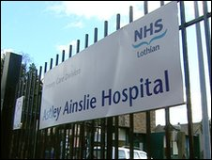
Creating a FND pathway- the experience of our neuro inpatient team.
Kirstin Dawson, clinical team lead OT Neurorehabilitation
Shelley Connon, clinical team lead PT Neurorehabilitation
Dr Imogen Dunlop, Neuropsychologist Neurorehabilitation
Dr Aly Nelson, consultant Neurorehabilitation Medicine

Slide 2
Overview
Introduction
Why develop a pathway?
Pathway
Case Studies
Learning

Slide 3
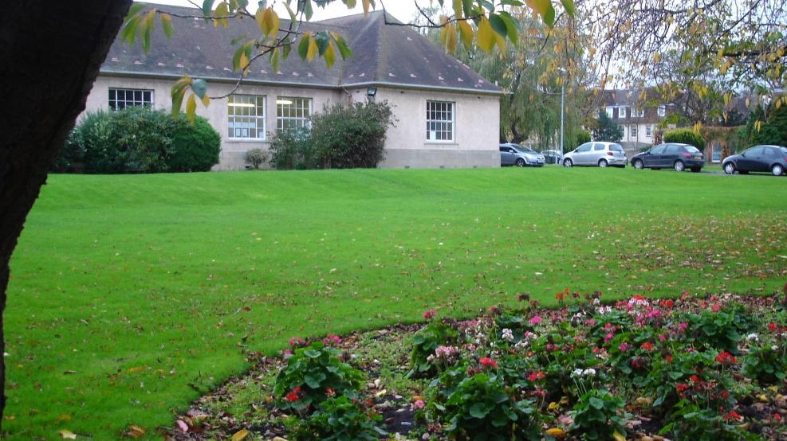
AAH Inpatient Neurorehabilitation
~40 inpatient beds
Specialist Neurorehabilitation Unit (BI / Stroke/ PND/ Spinal / CNS Tumours / neuropathies/FND…)
MDT
Environment – open wards / limited side rooms, structured environment.
Admissions are mainly from Lothian (occ. other health boards)
Mainly - Acute hospital admissions but can admit from home.
Part of a wider inpatient – outpatient pathway.

Slide 5
Import to consider biopsychosocial factors
It is potentially treatable
Recognised condition with positive clinical findings
It can coexist with other conditions
It causes significant disability and distress
Absence of psychological event does not exclude FND diagnosis
It is common
FND is NOT factitious or malingering

Slide 6
Our Local Experience- FND
Historically: Edinburgh fortunate to have world FND experts available.
From 2016 increasing numbers of referrals and admissions.
Length of stay – min 3 days – max 268 days
Mean length of stay 75 days
Our experience are of more complex presentations

Slide 7
2010-present
48 referrals
21 admitted
2016-2020
34 referrals
16 admitted
Likely underestimation of numbers this data represents admissions with FND as primary diagnosis.

Slide 8
Why develop a inpatient pathway?
Tended to be more complex presentations.
Resource intensive and increasing no.
Different treatment approach required.
Need for staff understanding/education.
Integrated MDT to provide a consistent, transparent approach. -patient trust /engagement & peer support
To identify who would benefit from admission.

Slide 9
AAH FND Pathway
Dr Imogen Dunlop, Neuropsychologist Neurorehabilitation

Slide 10
AAH FND Pathway: Referral/pre-admission
Diagnosis has been discussed with the patient prior to referral to AAH.
A statement of positive signs and symptoms has been shared with patient and AAH team.
Background information available.
Including social circumstances, mental health history and current support. Consider if need to involve wider support to optimise admission (e.g. advocacy/AMH/neuropsychiatry)

Slide 11
AAH FND Pathway – Pre-admission meeting with Patient
Understanding and acceptance of FND diagnosis.
Current symptoms (including pain, continence).
Detailed assessment of functional ability and current equipment –ideally F2F.
Clarify social situation/support consider: current POC; involvement of family; timing-any potential barriers to rehabilitation and/or discharge.
Mental wellbeing and support

Slide 12
AAH FND Pathway – Pre-admission meeting with Patient cont/
Explain rehabilitation process
Combination of single and integrated MDT therapy sessions.
Weekly MDT meeting (expected to attend).
Goal setting approach
Initial timeframe agreed – review if inpatient rehabilitation is right approach.
Discharge planning alongside goal setting.
Expectations re use of equipment on ward – may be different
Consider management plans whilst inpatient for managing certain symptoms e.g. dissociative seizures, self-harming

Slide 13
AAH FND Pathway – decision about admission
If Yes:
Clarify when all AAH MDT team members available.
How many FND patients currently on ward.
Arrange timed admission.
Consider if appropriate to ask patient to:
Monitor symptoms pre admission / generate an initial goals list to increase daily function/activity
What written materials will be given to the family and the patient
Consider community rehab. options post discharge prior to admission.
If No:
State clearly reasons for non-admission.
Consider if community rehab. options available / better option.
Consider how this information will be passed on
Is this decision under review? And if so what is the criteria.
No

Slide 14
AAH FND Pathway - Admission
First MDT meeting short (30mins) to set goals and consider the language patient wishes to use.
Weekly MDT meeting thereafter:
Review engagement and renew goals.
Review timeframe
Discuss discharge planning – are other services required/already involved
Focus on self-management
Goals for after hospital, support links while inpatient
Preparation for discharge including:
Relapse management.
Consider if a computer record alert would be helpful for future acute presentations.
Gather Patient Experience information at discharge and consider need to review experiences/ and function at later point.
MDT reflection meeting after each discharge.

Slide 15
Case Presentations
Kirstin Dawson, clinical team lead OT Neurorehabilitation
Shelley Connon, clinical team lead PT Neurorehabilitation

Slide 16
Case Study 1
Female in her thirties, high functioning, recent significant life stressors – break up with live in partner and loss of job, hx of low mood and eating disorder. Lived alone in 1st floor flat.
Diagnosed with FND year previously, living overseas – fully resolved functionally
Presented to acute services with LL weakness and altered sensation
Diagnosis confirmed GBS via NCS as well as significant overlay.
Was an inpatient in Acute for 2.5 months prior to t/f to AAH. W/chair bound and full body hoist on arrival to AAH.
Found Acute setting too unpredictable. Responded well to structure of the rehab environment and weekly MDT goal planning meetings.
Complex to treat due to underlying neuro condition that required ‘classic PT strengthening’. Did not like distraction and FND treatment approach (control aspect)
Made steady but slow progress : 4.5 month admission to AAH – mobile with e/crutch and able to do stairs on discharge. Neuro OP follow up - gained full functional recovery.
Psychology input beneficial – turning point was when pt found a new vocation / return to University to do Masters. Gave purpose and structure back to her life and glimmer of hope post discharge, allowing for more engagement in rehab

Slide 17
Case Study 2
Female in her 20s. Admitted to acute hospital presenting with functional tetraparesis secondary to dissociative seizures
PMH: Adverse life events, personality disorder – associated with numerous attempts at self-harm and chronic suicidal thoughts, ASD.
Pt went through pre-admission pathway process. Wider support already in place and agreement for ongoing input to support admission/discharge.
Planned 4 week trial – resulted in 18 week admission
Pt involved in setting up and reviewing contract for managing self-harm behaviours and dissociative seizures while an inpatient. Encouraged to take ownership of own rehabilitation.
Made good progress but required continuing input in community for both rehabilitation and wider support.
Home environment presented barriers to discharge

Slide 18
Ongoing review and learning
Try to explore and manage patient/ family expectations.
Right place, right time.
Pros/cons of time frame for admission.
Importance of communication and a collaborative relationship even where challenges.
Family involvement can be challenging but important and/or involving wider community support structure through admission and discharge planning.
Hospital environment can impact on progress positively and negatively.
In some cases MH and self harm behaviours can escalate in hospital environment – discussion of management plan/a contract in advance can be helpful.
One part of the pathway - we recognise that we have access to high level of expertise at diagnosis and community neurorehabilitation teams.
Goals beyond hospital helpful for patient progressing.

Slide 19
Thank you for listening

