Slide 1
The RFU’s approach to treating challenging behaviour: the use of group interventions

Slide 2
Surely a bad idea Cognitive and communication deficits after TBI
Disinhibition
Repetitive or disorganised thinking
Insensitivity to others
Difficulty following conversations with multiple participants
.....fitful, irreverent, indulging at times in the grossest profanity......manifesting but little deference for his fellows, impatient of restraint or advice when it conflicts with his desires, at times pertinaciously obstinate, yet capricious and vacillating...
Harlow, 1868

Slide 3
Part of broader treatment approach
RAID
Opportunities for green behaviours crucial
Relationship determines strength of reinforcement
Increased independence removes many frustrations

Slide 4
The power of identification
Bandura and the importance of similarity in social learning:
Similarity may be especially influential if uncertain about performance capabilities, self-doubts about performing well
Vicarious reinforcement: other patient demonstrating certain behaviours gets praise or even achieves discharge
Conversely observing models perform prohibited activities without negative consequences could (theoretically) lead to imitation of these
Bandura, A. (1986). Social foundations of thought and action: A social cognitive theory. EWglewood Cliffs, NJ: Prentice-Hall.
Notes:
From schunk
Bandura – children more likely to immitate behaviours displayed same sex models
Identification occurs with another person (the model) and involves taking on (or adopting) observed behaviors, values, beliefs and attitudes of the person with whom you are identifying.
Identification is different to imitation as it may involve a number of behaviors being adopted, whereas imitation usually involves copying a single behavior.
Modeled actions can serve as social prompts, such as when one emulates the behaviors of high-status models to obtain approval from others.
Observing similar others succeed at a task can raise observers' self-efficacy and motivate them to try the task themselves, because they are apt to believe that if others can succeed, they can as well.

Slide 5
Speech and Language Therapy (SLT)
Mel Hay (SLT)
Melanie.hay@nhslothian.scot.nhs.uk
Luke Hanson, Fay Morrice, Helen Page (SLTs)
Diana Mintal (SLT assistant)

Slide 6
Groups in SLT
Found in range of settings
Life participation approach
Promotes interactions with different communication partners
Notes:
Why do we do them? Eg communication is a 2 way process. 1-1 impairmant based therapy is not realistic.
Gives people the opportunities to use real life skills, practice key social and communication skills
(neurorehabilitation, paediatrics, mental health)
Some people feel more at ease talking with peers than members of staff
approach- real life communication opportunities incorporating long term goals

Slide 7
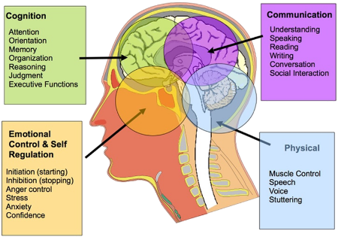
Influences
Functional rehabilitation
Dynamic and flexible groups
Patient feedback
Work history
Notes:
We know real life situations work best for communication work
Lots of our patients can’t manage 1-1 impairment based sessions
Work history- neurorehab, paeds, mental health, ALD

Slide 8
SLT Groups at the RFU
Name of group
Aims
Current Affairs
Bring Your Tune
Total Communication
Sensory Stories
Brain injury education group
Orientation, reasoning, attention and listening, expressing opinions
limited language demands, focusing on social communication
facilitating all modes of communication verbal and non-verbal
Incorporating all senses
Empowering, shared knowledge
Notes:
Tolerating others without falling out!

Slide 9
Current Affairs Group
Weekly open group
Communal area
Pre-prepared 3 articles (photos)
‘who/where/what happened’ questions
Think of a title
Notes:
Encouraged discussion and flexible thinking. Listening to other people’s ideas
SLTA would usually prep ideas
If someone in the group has a particular topic they would like to discuss further this can be incorporated

Slide 10
Positives and Challenges
Positives
Challenges
Short preparation time
Environment
Variety each week
Developed into debate group
Keeps patients informed
Intensive staff support
Environment
Not accessible to all (visuals and language levels)
Notes:
Keeps people aware of what’s going on outside the RFU
Also, what makes a successful group?
Patient feedback questionnaires, more than 1 person turning up
Sometimes we think that groups will reduce staffing, however often this is not the case

Slide 11
Bring Your Tune Group
Weekly open group
Approx 45 minutes
Communal area
Priming sessions for song ideas
Idea generation and reasoning
Listening to songs
Rating and scoring out of 3

Slide 12
Positives and Challenges
Positives
Challenges
Environment
Variety each week
Positive social interaction
Reduced language demands
Patient mix
Environment
Lengthy priming sessions
Competition
Patient mix
Notes:
Everyone invited!
Can be enjoyed by everyone
Competition difficult for some

Slide 13
The One That Didn’t Work
What happened?
Why?
Total communication group:
2 patients with severe aphasia practicing use of gesture/writing/drawing
Although able to produce excellent gesture they both hated it!
Different personalities
Environment
Resources
Expectations
Notes:
It’s ok to try and seen what works! 1-1 input was better for these individuals. Looked like a perfect match on paper
Too table top impairment based

Slide 14
Final Points About Groups
Functional communication
Patient mix
Staff support
Environment is key
Flexible and dynamic
Realistic expectations
Patient feedback
Notes:
1-1 therapy is often not functional. People need to opportunity to interact with peers/other staff members/unfamiliar people
Just because someone has similar communication strengths and needs does not mean that they will make a good group
Groups are not always the answer to seeing multiple patients at once, often staffing heavy. Be creative, involve nursing/volunteers/well known domestic staff
Be inclusive, patient lead as possible, not teacher/student relationship. If more targeted group eg BI education a quieter room may be needed
Folow patient needs and interests to help keep groups feeling fresh and to ensure maintained interest
Don’t expect 2 much. 3 people can count as a group! Some weeks and groups will go better than others.
Gain and listen to patients feedback to make relevant changes
Staff support and willingness to try

Slide 15
Occupational Therapy
Alice Landrock (Team Lead)
Alice.Landrock@nhslothian.scot.nhs.uk
Maureen Andress (assistant)
Helen O’Leary (Rotational OT)
Notes:
I would like to use this opportunity to let you know about my personal experience of running groups at the Robert Fergusson Unit.
Perhaps you have a lot of experience of facilitating groups yourself, or you are interested in starting one. I hope that hearing my experience will give you some ideas. If you have any suggestions for me I would love to hear them.

Slide 16
Groups in OT
Nothing new – facilitating groups is a core component of delivering an OT service, especially within a mental health setting.
At the RFU we strive to offer a biopsychosocial model of care that focuses on improving mental health, cognitive recovery and physical rehabilitation. Group work contributes to this rehabilitation approach.
Notes:
Although the RFU is not a mental health ward, it is also not traditional neurorehabilitation either.

Slide 17
Influences
Influences
The practice of OT is dynamic. Influenced by social policy, research, personal experiences, our client group and feedback.
Every OT service will look slightly different
Notes:
The therapeutic use of self is shaped by our past experiences, my previous experience has been in Mental health and forensic learning disability
Older peoples community mental health service, I was exposed to many groups, facilitated by a number of occupational therapists
Adult mental health vocational rehabilitation service

Slide 18
RFU OT Groups (the ones I can remember)
Breakfast
Mens baking
Curry club
Collaborations with Art Link
Music appreciation
Newspapers / current affairs
Points of view forum
Brain injury education
Art / craft / model building
Photography
Work skills
Gardening
Active Minds - Quiz / cognitive thinking games
Active Bodies – active games / bike rides
Walking
Swimming
Communication with SLT
Smoothie making and tasting
Events preparation
Armchair exercises

Slide 19
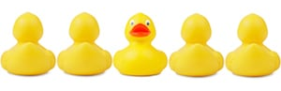
Groups that stuck out
RFU Points of view – Service user and staff forum
Works skills – vocational skills
Curry club – team work and basic kitchen skills
Swimming – participating in community activity
Producing music video (collaboration with Art Link)
Breakfast group – normalisation, essential cooking skills,
Smoothie group – sensory, communication
Notes:
Pre vocational skills group – real job, admin, light industrial tasks, stock taking etc. Focusing on phycial – fine, gross motor skills, fatigue management, stamina, cognitive – time keeping,
Curry club -

Slide 20
Something special
Roles and responsibilities to be an equal with many skills and attributes to contribute. Be a chef, an influencer, a worker or volunteer. Use of patient / staff charter. Each group has general aims, but each patient has their own goals that can be worked on within the group activity.
Group Process – Forming, Storming, Norming, Performing, Adjuring.
Continuity, timing and routine in a ward are very important, it can take time to develop this. Don’t be disheartened if the group takes time to get established. 2 patients is a group.

Slide 21
Tuckman’s Model of Group Work

Slide 22
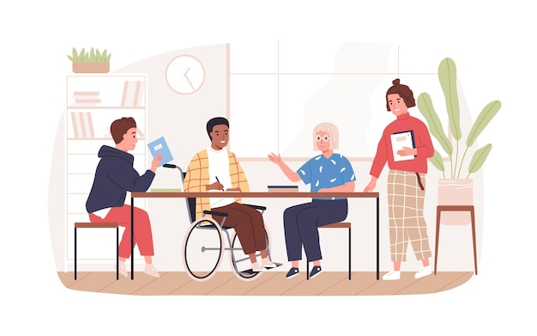
RFU Points Of View
Service user and staff forum.
Open to all patients and staff at the Robert Fergusson Unit

Slide 23
How to run the group
Practicalities
Chaired by OT or SLT staff.
Weekly group, Mondays 2-3pm
Group set the agenda (with a backup idea, just in case)
Minutes and Actions are documented in a formal meeting process
The group is held in the main, communal area of the ward. Enough room for all patients and staff to attend.
Equipment: notebook to take minutes, flip chart to record discussions in an accessible way.
Tuckman’s Theory of group work:
Regularly review group process, Forming, Storming, Norming, Performing

Slide 24
Aims of the Groups
Opportunity for people to get together and be part of a group – inclusive RFU community
Plan activities that people would like to take part in
Provide an opportunity for everyone to be involved in service improvement activities
Provide an opportunity for people to discuss issues that impact on them
Bridge the gap between service users, staff and service managers – and to ensure that service users voices are heard.

Slide 25
Some Of Our Achievements To Date
Service improvement – piloting feedback questionnaires and service information leaflets
Selecting sound canceling artwork for the ward
Planned and hosted a ward party – all patients, staff, families and friends were welcome
Planed regular events – RFU’s got talent, Halloween party, Indoor Olympics,
Looked at building plans for the new unit and met with project manager to ask questions and give opinions.
We have had political discussions - leading to everyone who wanted registering to vote in referendums and elections
Discussed activities that are on in the ward and wider hospital, making sure that everyone knows what is available

Slide 26
The one that didn't work
Relaxation group for men
Individual sessions working well – staff intensive – up to 3 hours a week
Attempted a group, dynamics were not conducive for peer support or relaxation. Very sexually inappropriate verbal comments directed at the OT.
Lessons learnt
I approached it as through the group was already formed. I forgot about group process. Jumped straight in, forgot about setting boundaries, shared aims, expectations.
One session does not mean that the group is not going to be useful, developing a group takes time

Slide 28
Art Psychotherapy groups at Robert Fergusson unit this is a very brief overview of group work for further detail and references please contact therapist .
Therapist Lynda Girvan
The mind is complex , dynamic and sensitive to presence of other minds. I approach with creative apperception and curiosity.

Slide 29
Introduction
Art therapy is an established psychological therapy delivered by trained art psychotherapists. Art-making, alongside development of the therapeutic relationship is central to the intervention .It’s designed to help anyone ,including those affected by adverse experiences , illness or disability , by supporting their social , emotional and mental health needs. All sessions are collaborative and actively involve the service user to work towards co-design and goal setting.
Research gathered from RCTs and Patient Reported Experience Measures consistently show positive changes;- Self-esteem, motivation, ability to communicate and relate to others, ability to manage strange feelings , and to develop focus and attention .
Art psychotherapy has been part of the Robert Fergusson Unit service since 1999 more recently we have supported Music therapy trainees and look forward to more input here .

Slide 30
Will people get it ?
For a long time, brain damage was considered to be contraindicated for verbal psychotherapy. This has changed with the development of the neuro-psychoanalysis movement , especially the work of Mark Solms and Oliver Turnbull 2002
In 1980 Prigatano recommended art as part of psychotherapy treatment this has been in use since 1980’s.
The connection between Art psychotherapy and Neurological rehabilitation has been researched into and practice explored since 1980’s. Clinical Practice Guidelines are also published there see BAAT Forum www.baat.org.
Publications :- Art therapy with Adults with Physical Conditions and Art Therapy with Adults with Neurological Conditions edited by S. Weston and M. Leibmann gives good examples of work with this clinical population.
BAAT Special Interest Group Arts therapy in Neurology set up in 1999 , continues to meet and network developing best practice with this population … We invite people to come and present about their work . Please contact if you are interested in doing this and finding out about our work.

Slide 31
Service integration is about preparing the ground and involves working with groups of patients and staff also professional groups to ensure safety and continuity of practice. Sharing approaches and techniques to support understanding is achieved in the following ways:- Once therapy position and approach is understood and tolerated, it is possible to develop informed consent and support choice making.
Maintaining art psychotherapy principles and values in MDT team group and in working groups
Experientials groups for staff
Case study presentation to small staff groups
Open studio groups involving staff using psychoeducational approach
Sharing practice and received wisdom in-house groups
Sharing papers of interest and links with team via inpatient team web links
Sharing Trauma informed practice standards

Slide 32
Patient situation
Out of area – attachment narratives stimulated .
People are at different stages in their recovery.
Presenting behaviour can appear confusing , people are ( staff and patients) vulnerable to having their communication about experience misunderstood or pre-empted. Risk of testimonial injustice and body doubt if experience is not actively worked with and thought about. Experience of being in group has to be stabilised.
Disturbance of sensory processing can result in complicated interpersonal and intersubjective meeting;- self /other management is complicated , this makes essential ADLS difficult to achieve and dependency a more significant presence in the social exchange.
Due to the degree of emotional associated with ABI how therapy is integrated into the recovering mind brain is not known at the start - the work is always trauma informed and nuanced .

Slide 33
Reflective practice is Mentalization
The practice of mentalisation is nothing new . It is an evidenced based methodology , developed over many years , informed by psychodynamic , person centred and trauma informed practice. It is specifically used to address needs of service users with borderline personality disorder see references .
As behavioural presentation in this setting can be confusing and self/ other perception compromised. This psychodynamic model helps to chart the individual within the group domain.
Mentalization scope :-
Automatic – Controlled
Self -other
Inner –Outer
Cognitive – affective
The dimensions of Mentalization are nurtured in our primary groups family context and developed through life.

Slide 34
Therapist approach in Groups
The art work can hold evidence of physical and emotional challenge .
This has to be viewed within the context of the work and is not fixed in meaning . As the therapeutic relationship changes what is worked with will develop also . To safeguard against intrusive work we always reflect and review with the service user.
The art therapist is mindful of and working with :-
Perceptual disturbance.
The persons creativity.
Visual processing weakness.
Getting used to changes in experience of materials , tools, activity and helps to map blind spots.
Confidence building in social and interpersonal relating
Developing point of view about 3D Space ;- in art psychotherapy we consider different types of space perceptual , actual, experiencing and personal.
Navigate and respect areas of emotional and cognitive vulnerability.
Working with the fragile and traumatised individual.

Slide 35
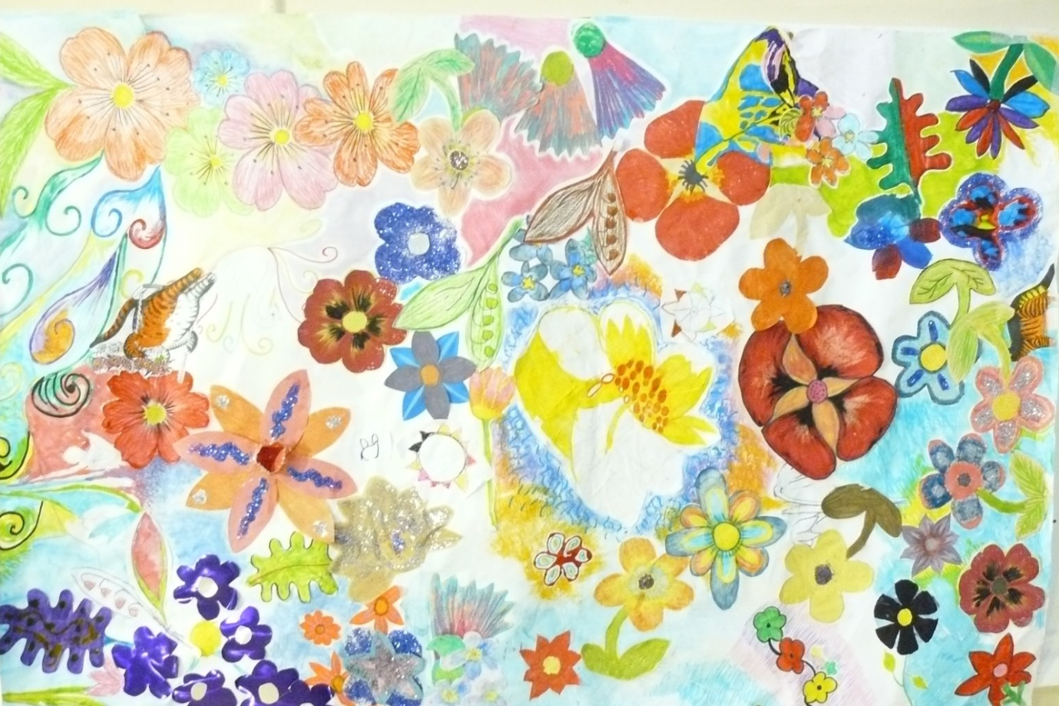
The Robert Fergusson Unit has supported Art Psychotherapy groups since 1999 . The Interpersonal model (Yalom) is designed for inpatient work. All sessions are developed reciprocally mindful of patient change clinical state and large group dynamic.
Examples of groups
Open studio group Opportunity to explore language of art , think about being alongside others .
Closed groups focus on specific items such as preparing for discharge . Managing expectation , reviewing therapy gains.
Mindful groups- Here and now focus can address tension on unit and difficult interpersonal relations
Reflective groups - Actively using art making to support return to good-enough Mentalization
Men's group and Women’s group
Open group work provides a forum to make choices around personal therapy needs. People often decide to move on to one on one work to explore more personal issues Example of MDT collaborative working.
People who contributed agree the work can be shared.

Slide 36
Welcome to our island - this is what we say about being here ..
We are here to live well again.
Sometimes being here can feel like a long bus journey .. Things can feel stuck and need to be worked with differently.
Understand me understand my progress.
My history my life. My playlist, my choice.
Get that -Brain injury is only part of who I am- not the whole me. This place is temporary .
We all need to find our courage and respect for healing.
We will work together to make sure -Our rights are respected our choices supported .
Our sessions are co-designed - this is partnership working
We need to strengthen our Faith and hope.
We have rules too
Please stop rewind and check out your assumptions Forgive me for making mistakes .
Reflective
Group focus is on experience, findings ways to cope with situation ,talk about therapy and life goals

Slide 37
Group values
Reflective space
being present with feelings, engaging with process and with others .
Initiation and agency is practiced
‘ I am before I do’..
Instillation of hope
Finding and talking about therapy and life goals . Practicing control in ‘here and now’ and future planning.
Imparting information
My experience and Personal boundaries.
Recapitulation of family group
Universality ...
Reflective space
being present with feelings, engaging with process and with others .
Initiation and agency is practiced
‘ I am before I do’
Instillation of hope
Finding and talking about therapy and life goals . Practicing control in ‘here and now’ and future planning.
Imparting information
My experience and Personal boundaries.
Recapitulation of family group
Universality

Slide 38
What service users said. “It has been good” “Yes being in the group could be useful” “We have time to talk” “Being in the group is good for mental health” “People need to know what I am like and what my triggers are” “ We can continue with the group”
Approximately 80% of service users decide to continue in groups
Groups last 3 – 9 months with step back time
2 groups per annum
People can opt in and out and take breaks if needed . They tend to stay .
Positive group culture on the unit.
Positive uptake of art psychotherapy at the Fergusson unit since 1999.

Slide 39
Structured reflection:– all reports, assumptions and feedback within wider treatment setting is shared with service users .
MBT joint formulation document RF scale evidences some move towards greater awareness and capacity to take on new learning.
Patient reported experience measures PREM after each cohort – discussed with service users independently . Responses included in qualitative data .
Combined art therapy assessment and treatment measure CATSRS to graph level of engagement over 6wk period Discussed with service users independently.
Feedback and check in about group process at the end of sessions
Goal Based outcome measures – group goals will be discussed and agreed in group

Slide 40
Benefits
Acceptability in impaired insight
Peer feedback more acceptable and greater impact
Modelling, reinforcement of appropriate behaviour in a social setting, vicarious learning from peers
Identification with others (adjustment)
Assess social skills
Assess ability to make judgments/decisions in dynamic situation
Group setting may be more generalisable
Notes:
People generally do things with others. May be doing meal prep with carers, for example

Slide 41
Tips and themes
Importance of task (versus verbal psycho-education/therapy) focus
Achieve identified end product (e.g. specific decisions, recommendations or tangible results)
Appropriate choice of members (similar areas of weakness or complementary)
Therapist as facilitator
If challenging behaviour need more than one facilitator
Nursing support crucial
NOT really resource saving (but achieve things other formats can’t)
Notes:
. Ideally, group members should have similar areas of weakness, so that specific areas of deficit may be addressed as a group.

